Slide 1
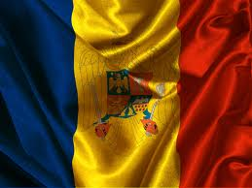
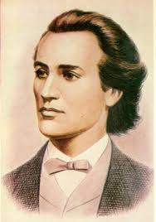
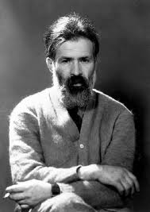
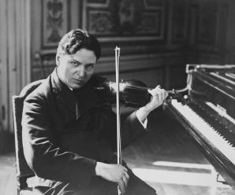
Romanian celebrietes

Slide 2
Cultural Romania
Romania has a unique culture, which is the product of its geography and of its distinct historical evolution. Like Romanians themselves, it is fundamentally defined as the meeting point of three regions: Central Europe, Eastern Europe, and the Balkans.

Slide 3
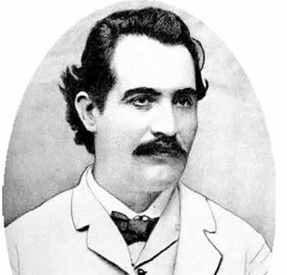
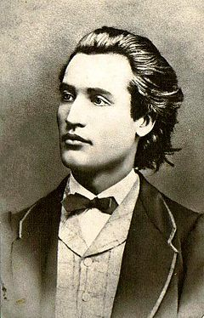
Literature Icon Mihai Eminescu – Romania’s national poet

Slide 4
The novelist, poet and essayist
Herta Muller
She received the Nobel Prize in Literature in 2009

Slide 5
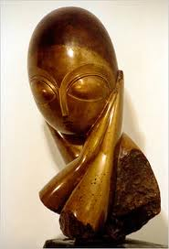
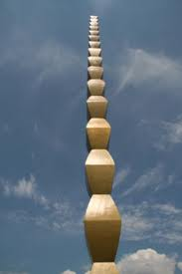
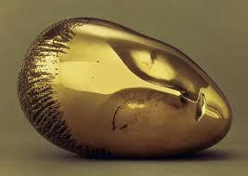
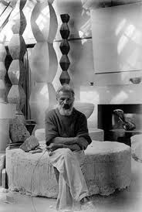
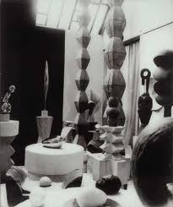
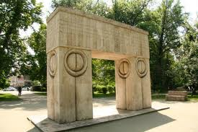
Constantin Brancusi - prominent sculptor

Slide 6
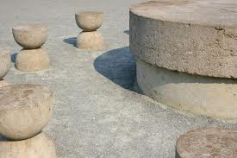
Constantin Brancusi- some masterpieces
"
Sleeping Muse (1908),
The Kiss (1908),
Prometheus (1911),
Mademoiselle Pogany (1913),
The Newborn (1915),
Bird in Space (1919)
The Column of the Infinite popularly known as The Endless Column (1938).
Considered the pioneer of modernism, Brâncuşi is called the Patriarch of Modern Sculpture.

Slide 7
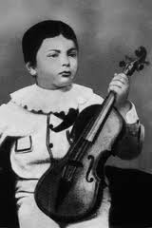
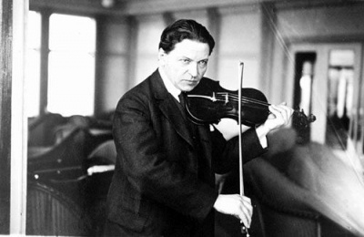
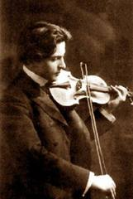
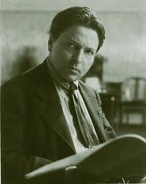
George Enescu Romania's greatest composer

Slide 8
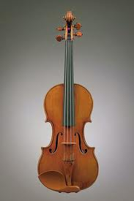
George Enescu
The annual George Enescu Festival is held in Bucharest in his honor.

Slide 9
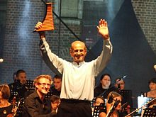
Gheorghe Zamfir "The Master of the Pan Flute"
Zamfir is considered the most important person to popularize the pan flute worldwide and his interpretations can be heard on the soundtracks of many Hollywood movies.

Slide 10
Romanian modern music celebrieties

Slide 11
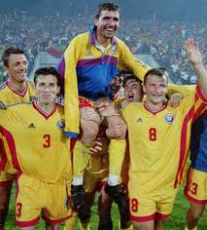
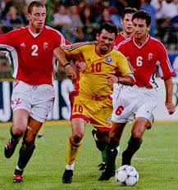
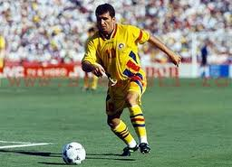
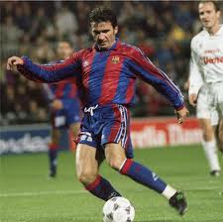
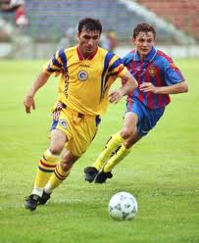
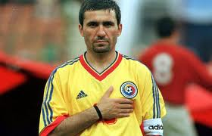
Gheorghe Hagi footballer , coach

Slide 12
Gheorghe hagi
Galatasaray fans called him ‘Commandante’ (The Commander) and the Romanians call him REGELE ( The King ).
Nicknamed “The Maradona of Carphatians”, he is considerd a hero in his homeland as well as in Turkey.
He played for the ROMANIAN NATIONAL TEAM in three WORLD CUPS in 1990 , 1994 and 1998 , as well as in three EUROPEAN FOOTBALL CHAMPIONSHIPS in 1984 , 1996 and 2000.

Slide 13
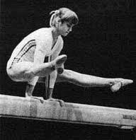
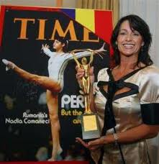
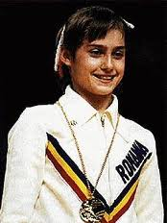
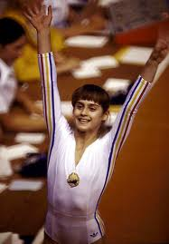
Nadia Comaneci gymnast

Slide 14
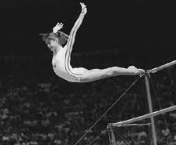
Nadia Comaneci
Nadia Elena Comăneci (born November 12, 1961) is a former Romanian gymnast. She is famous for scoring the first ever perfect 10 in Olympic gymnastics history in the 1976 Summer Olympics in Montreal, Quebec, Canada. Nadia scored six perfect scores in Canada.

Slide 15
Emil Palade – "the most influential cell biologist ever", in 1974 he was awarded the Nobel Prize in Physiology and Medicine, together with Albert Claude and Christian de Duve. Ana Aslan – was a Romanian biologist and physician. She is considered to be a founding figure of gerontology and geriatrics in Romania.
Scientific Romania

Slide 16
I love Romania

